Slide 1
ETL PROCESS A complete Guide
Done By
Mohamed Yusuf R
Crescent University
B.Tech IT-4th Year

Slide 2
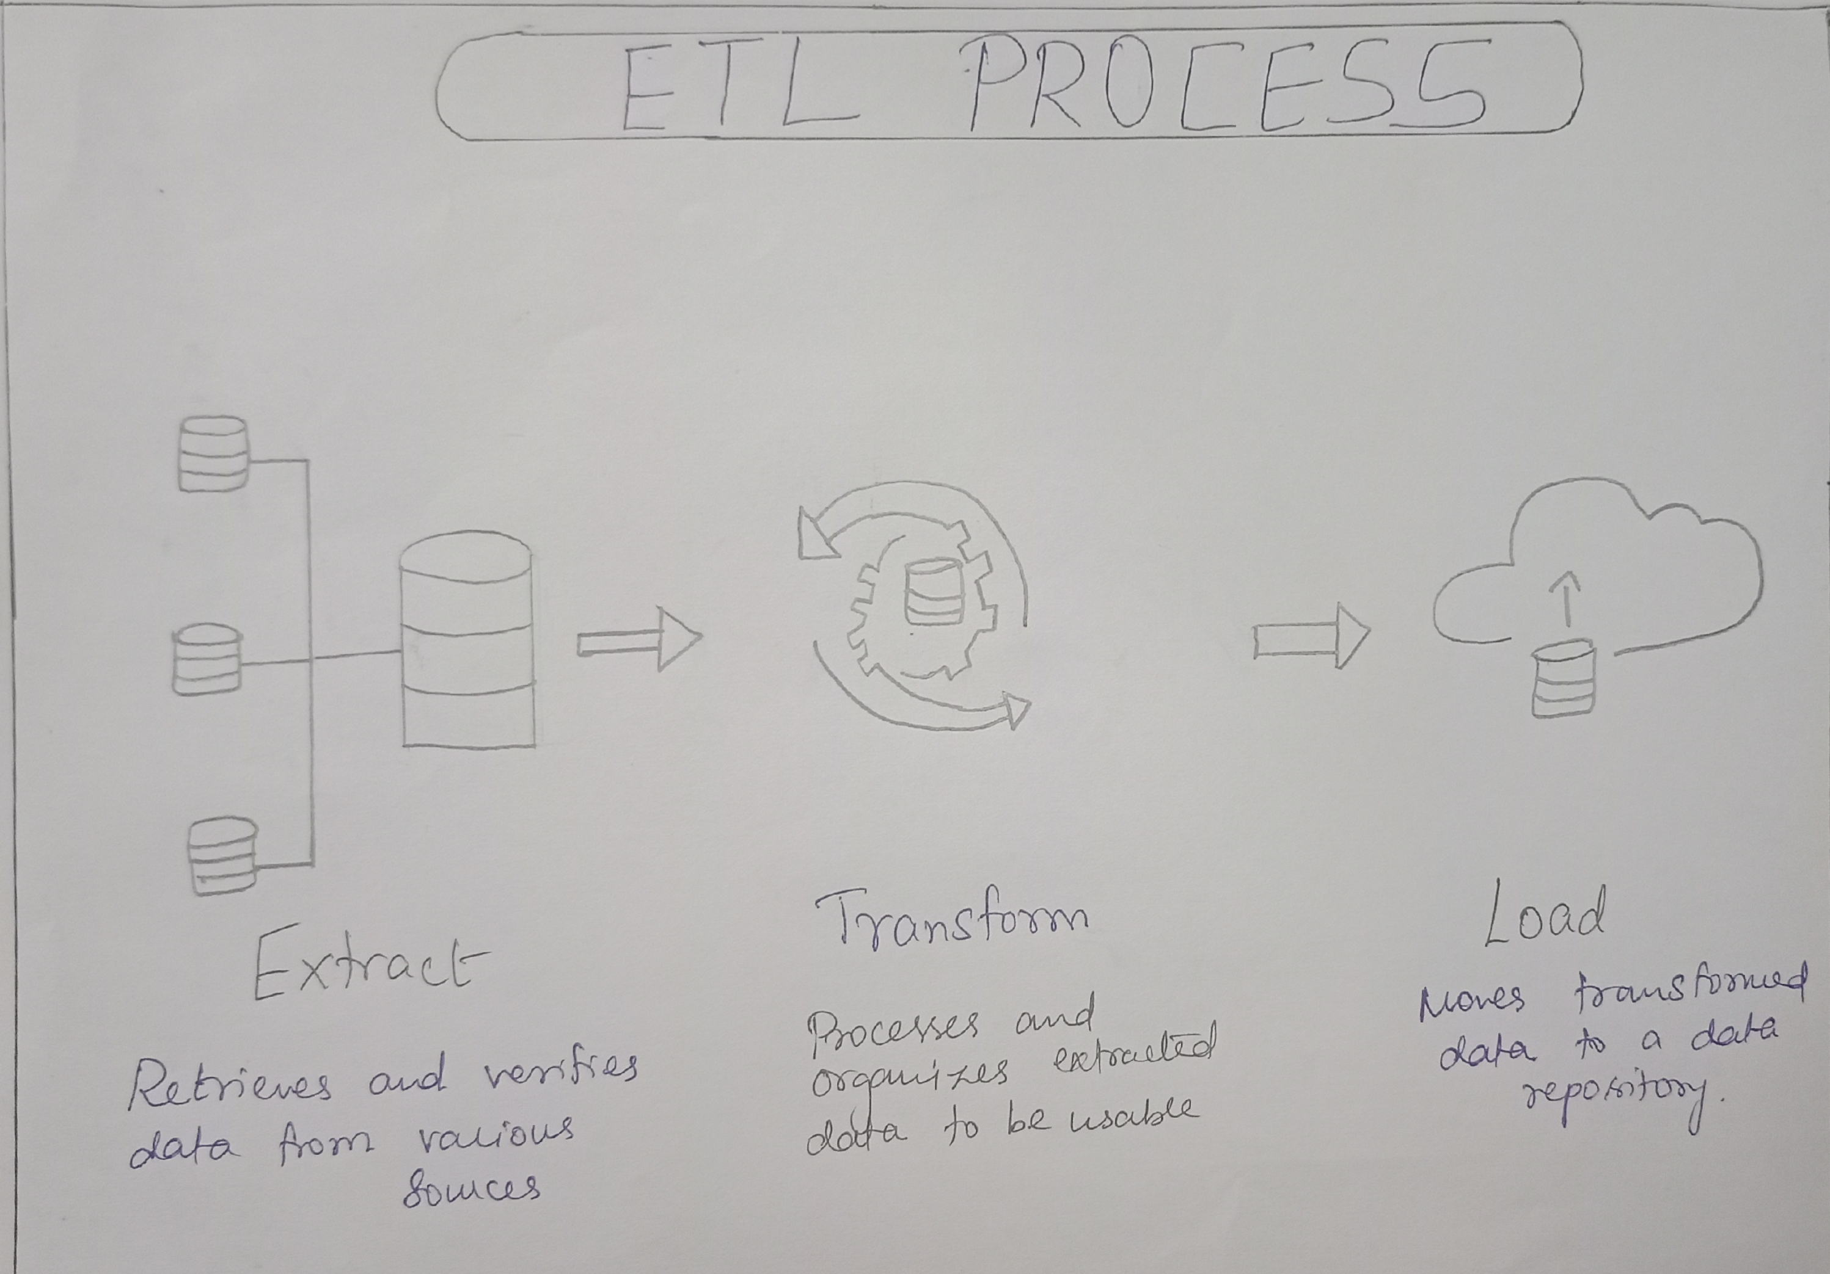
HAND DRAWN DIAGRAM:-

Slide 3
How the process happens:-
The ETL (Extract, Transform, Load) process is a critical component of data integration and data warehousing. It involves the movement and manipulation of data from source systems to a target system, typically a data warehouse, for analysis and reporting.
Extraction (E):
Identify Sources: Determine the source systems from which data needs to be extracted. These sources can include databases, flat files, APIs, web services, and more.
Data Extraction: Extract data from the source systems. Depending on the source, this can be a one-time extraction or a regular, scheduled process.
Change Data Capture (CDC): In some cases, only the changed or new data needs to be extracted since the last ETL run to minimize the amount of data transferred.
Transformation (T):
Data Cleansing: Cleanse the data to remove errors, inconsistencies, duplicates, and missing values. This step is essential for ensuring data quality.
Data Mapping: Map source data to the target data model. This involves defining how data from the source will be transformed and loaded into the target system.
Data Transformation: Apply various transformations to the data, such as filtering, sorting, aggregating, and joining datasets. You may also perform calculations or derive new columns during this stage.
Data Enrichment: Enhance the data by adding additional information from external sources or lookup tables.
Data Validation: Validate the transformed data to ensure it meets business rules and requirements.

Slide 4
3.Load (L):
Data Staging: Load the transformed data into a staging area. This is an intermediate storage location where the data is temporarily stored before being loaded into the target system. Staging helps in data validation and ensures that only clean data is moved to the target.
Data Loading: Load the data from the staging area into the target data warehouse or data mart. This can be done using batch processing or real-time streaming, depending on the requirements.
Indexes and Constraints: Create indexes and enforce constraints on the data in the target system to optimize query performance and maintain data integrity.
Historical Data: In some cases, historical data is preserved to enable trend analysis and historical reporting. This may involve handling slowly changing dimensions (SCDs) and managing historical records.
4.Monitoring and Maintenance:
Implement monitoring and logging to track the ETL process's performance, errors, and data quality issues.
Schedule ETL jobs to run at appropriate intervals (e.g., daily, hourly) or trigger them in response to real-time events.
Implement error handling and notifications to alert stakeholders in case of ETL failures or data quality issues.
Periodically review and update the ETL process to accommodate changes in source systems, business requirements, or data volumes.

Slide 5
Tools used in ETL process:-
1.Extraction Tools:
-Apache Nifi
-Talend
-Informatica PowerCenter
-Microsoft SQL Server Integration Services (SSIS)
-Apache Sqoop
-Custom Scripts
2.Transformation Tools:
-Apache Spark
-Apache Hadoop MapReduce
-Pentaho Kettle (now known as Hitachi Vantara Pentaho)

Slide 6
-SQL
-Custom Code
3.Loading Tools:
-Amazon Redshift
-Google BigQuery
-Snowflake
-Microsoft Azure Data Factory
-Apache Nifi
-Custom Scripts

Slide 7
Real time example:-
SCENARIO:-
Here the ETL process is done for an ECOMMERCE company
Step 1: Extraction
Identify Sources:
Data from Ecomm online store database.
Data from physical retail stores.
Data from external suppliers.
Data Extraction:
Extract daily sales data from the online store's relational database using SQL queries.
Collect sales data from physical retail stores by exporting CSV files from their point-of-sale systems.
Receive daily sales reports from external suppliers via FTP (File Transfer Protocol).
Change Data Capture (CDC):
For the online store, use CDC to only extract new orders and updates to existing orders since the last extraction.
For physical stores and external suppliers, the entire daily dataset is extracted

Slide 8
Step 2: Transformation
1.Data Cleansing:
Cleanse the data by removing duplicate records, handling missing values, and standardizing data formats.
2.Data Transformation:
1.Calculate additional metrics like total revenue, average order value, and sales by product category.
2.Merge data from different sources to create a unified dataset.
3.Data Validation:
Validate the data to ensure that all transactions are complete, and the data adheres to predefined business rules.

Slide 9
Step 3: Loading
1.Data Staging:
Load the cleaned and transformed data into a staging area for validation and further processing. This staging area could be a separate database or cloud storage.
2.Data Loading:
Load the data from the staging area into the data warehouse, which could be a system like Amazon Redshift, Google BigQuery, or a custom-built data repository.
3.Indexes and Constraints:
1.Create indexes on key columns for efficient querying.
2.Enforce constraints to maintain data integrity.
4.Historical Data:
In the data warehouse, implement a slowly changing dimension (SCD) strategy to handle historical data for customer and product attributes, enabling historical trend analysis.

Slide 10
Major elements in ETL Process:-
Data Extraction (E)
Data Transformation (T)
Data Loading (L)
Job Orchestration
Metadata Management
Data Quality Assurance
Security and Compliance
Performance Optimization
Documentation and Reporting

Slide 11
Data Warehouse:-
A data warehouse is a specialized type of database designed for the efficient storage, retrieval, and analysis of large volumes of data. It serves as a centralized repository that collects, integrates, and stores data from various sources, making it accessible for business intelligence (BI), analytics, and reporting purposes. Data warehouses play a critical role in helping organizations make data-driven decisions.
A data warehouse is a centralized, integrated, and subject-oriented repository of data collected from various sources within an organization. It is designed to support business intelligence (BI), reporting, and data analysis activities. Data warehouses are constructed to provide a historical, consistent, and optimized view of an organization's data, making it easier for decision-makers to access and analyze information for strategic planning and decision-making.

Slide 12
Different Warehouses Available:-
Amazon Redshift
Google BigQuery
Snowflake
Microsoft Azure Synapse Analytics (formerly SQL Data Warehouse)
IBM Db2 Warehouse on Cloud
Oracle Autonomous Data Warehouse
Teradata
SAP HANA
Exasol
CockroachDB

Slide 13
How to use Data Warehouse:-
1.Data Warehouse Setup:
Choose a Data Warehouse: Select a data warehouse solution that suits your organization's needs, such as Amazon Redshift, Google BigQuery, or others mentioned earlier.
Provision Resources: Configure and provision the necessary computing and storage resources in your chosen data warehouse platform. This often involves selecting the appropriate instance size and storage capacity.
Data Ingestion: Use ETL (Extract, Transform, Load) processes to extract data from various source systems, transform it as needed, and load it into the data warehouse.
2. Data Modeling and Schema Design:
Define Data Structures: Design the schema (structure) of your data warehouse tables. This includes deciding on how data will be organized into facts (measurable data) and dimensions (descriptive attributes).
Create Indexes: Set up indexes to optimize query performance for frequently accessed columns.

Slide 14
3. Data Integration:
ETL Processes: Continue to run ETL processes to keep your data warehouse up to date with fresh data from source systems.
4. Data Access and Querying:
Connect Tools: Use BI (Business Intelligence) tools, data analytics platforms, or programming languages like SQL to connect to your data warehouse.
Write Queries: Write SQL queries or use visual query builders to retrieve and analyze data. You can write queries to aggregate data, filter records, and perform complex calculations.
Optimize Queries: Optimize your SQL queries to ensure they run efficiently. This may involve using indexing, tuning, and avoiding expensive operations.
Security: Implement security measures to control access to your data warehouse. Most data warehouses offer role-based access control (RBAC) and encryption options.
5. Data Visualization and Reporting:
Business Intelligence Tools: Use BI tools like Tableau, Power BI, or Looker to create reports and dashboards that visualize your data.
Custom Dashboards: Build custom dashboards and reports to track key performance indicators (KPIs) and monitor business metrics.

Slide 15
6. Monitoring and Performance Tuning:
Performance Monitoring: Continuously monitor the performance of your data warehouse to ensure that queries run efficiently.
Resource Scaling: Adjust resources (e.g., compute power, storage) based on changing data volumes and query loads to maintain performance.
7. Data Governance and Compliance:
Data Governance: Implement data governance practices to maintain data quality, lineage, and documentation.
Compliance: Ensure that your data warehouse adheres to regulatory compliance standards relevant to your industry.
8. Backup and Disaster Recovery:
Regular Backups: Implement regular backups to protect your data warehouse against data loss or system failures.
Disaster Recovery Plan: Develop a disaster recovery plan to ensure data availability in case of unexpected events.

Slide 16
9. Training and Support:
User Training: Train users and analysts on how to use the data warehouse and associated tools effectively.
Support and Documentation: Provide documentation and support for users, including SQL documentation and troubleshooting guides.
10. Scaling and Growth:
Scaling: As your data needs grow, be prepared to scale your data warehouse resources and infrastructure accordingly.
Data Quality Improvement: Continuously work on improving data quality and addressing data issues as they arise.
Using a data warehouse effectively involves not only technical expertise but also a good understanding of your organization's data needs and objectives. Regularly assess the performance, security, and usability of your data warehouse to ensure it continues to meet your business requirements.

Slide 17
Advantages of Data Warehouse:-
Centralized Data Storage
Improved Data Quality
Historical Data Analysis
Subject-Oriented Data
Optimized Query Performance
Scalability
Enhanced Data Security
Data Integration
Support for Complex Queries
Data Governance
Business Intelligence and Analytics
Data Sharing and Collaboration
Cost Savings
Strategic Decision-Making
Competitive Advantage

Slide 18
Data Lake:-
A data lake is a centralized repository that allows organizations to store vast amounts of structured and unstructured data at scale. Unlike traditional databases and data warehouses, data lakes are designed to accommodate data in its raw, native format, without the need for extensive preprocessing or schema definition upfront. Data lakes have become a fundamental component of modern data architectures, enabling organizations to store, manage, and analyze a wide variety of data types efficiently.

Slide 19
Different Data Lake Available:-
Hadoop Distributed File System (HDFS)
Amazon S3 (Simple Storage Service)
Azure Data Lake Storage
Google Cloud Storage
AWS Lake Formation
Azure Data Lake Analytics
Google Cloud Dataprep
Databricks Delta Lake
Qubole
Cloudera Data Lake

Slide 20
How to use Data Lake:-
1. Define Your Data Lake Strategy:
Identify Use Cases: Determine the specific use cases and business objectives for your data lake. What kind of data do you want to store, and what insights are you looking to gain?
Choose a Data Lake Technology: Select the data lake technology or platform that aligns with your organization's needs, whether it's on-premises or cloud-based.
2. Data Ingestion:
Ingest Data: Begin by ingesting data into your data lake. This can include structured data (e.g., relational databases), semi-structured data (e.g., JSON, XML), and unstructured data (e.g., log files, documents).
ETL/ELT Processes: Depending on your data lake technology, implement Extract, Transform, Load (ETL) or Extract, Load, Transform (ELT) processes to clean, transform, and structure data as needed. Some data lakes accept data in its raw, native format.
Batch and Stream Processing: Consider whether you need batch processing or stream processing to ingest real-time data.

Slide 21
3. Data Organization and Storage:
Choose Data Lake Storage: Decide where to store your data. Common choices include cloud object storage (e.g., Amazon S3, Azure Data Lake Storage) or on-premises distributed file systems (e.g., HDFS).
Organize Data: Create directories or containers to organize data logically. Use folders or partitions to structure data, making it easier to locate and access.
Metadata Catalog: Implement a metadata catalog or data catalog to index and describe the data stored in the data lake. This helps users discover and understand available data assets.
4. Data Security and Governance:
Access Control: Implement robust access controls and security measures to protect sensitive data. Define who can access, modify, and delete data.
Data Encryption: Encrypt data at rest and in transit to ensure data security.
Data Governance: Establish data governance practices to maintain data quality, lineage, and compliance with data policies and regulations.

Slide 22
5. Data Processing and Analytics:
Select Data Processing Tools: Choose data processing and analytics tools that can work with data lakes. This may include Apache Spark, Presto, Hive, or cloud-native services like AWS Athena or Google BigQuery.
Data Exploration: Use data exploration and visualization tools to interact with data and gain insights. Tools like Tableau, Power BI, or Jupyter notebooks can be useful.
Machine Learning and Advanced Analytics: Leverage machine learning frameworks and libraries to build predictive models and uncover patterns in the data.
6. Data Lifecycle Management:
Data Retention Policies: Define data retention policies to manage the lifecycle of data. This includes archiving or deleting data as it becomes less relevant.
7. Monitoring and Optimization:
Performance Monitoring: Continuously monitor the performance of data lake queries and processes. Optimize queries and resource usage for efficiency.
Cost Management: Keep an eye on storage and processing costs. Adjust storage and compute resources based on changing needs.

Slide 23
8. Documentation and Training:
Documentation: Document data lake structures, metadata, and processes to make it easier for users to understand and work with the data.
User Training: Provide training to users and analysts on how to effectively use the data lake and associated tools.
9. Data Sharing and Collaboration:
Data Sharing: Implement mechanisms for securely sharing data with authorized users, both within and outside your organization.
10. Backup and Disaster Recovery:
Backup: Implement regular data backups to ensure data availability and recovery in case of unexpected events.
11. Scaling and Growth:
Scaling: As your data needs grow, be prepared to scale your data lake resources and infrastructure accordingly.

Slide 24
Advantages of Data Lake:-
Flexible Data Storage
Scalability
Low Data Transformation Overhead
Schema-on-Read
Cost-Effective Storage
Data Variety
Analytics and Processing Flexibility
Real-Time Data Processing
Advanced Analytics and Machine Learning
Data Exploration and Discovery
Data Governance and Security
Integration with Data Warehouses
Competitive Advantage

Slide 25
THANK YOU

